Slide 1

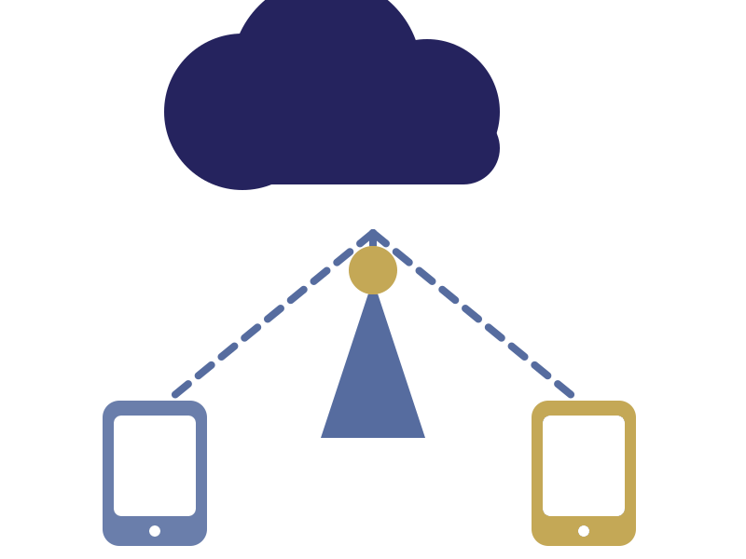

LORDS INSTITUTE OF ENGINEERING & TECHNOLOGY
UGC Autonomous Institution, Hyderabad-500091, TS.
Department of Computer Science and Engineering
MAJOR PROJECT | FINAL YEAR
GraphRAG-Based Enterprise
Knowledge Discovery System
Domain: Knowledge Graphs, RAG & Enterprise AI
Team Members | CSE IV-B1_18
Abdul Raafeh – 160923733072
Mohammed Affanuddin – 160923733078
Patan Sameer Khan – 160923733086

Slide 2
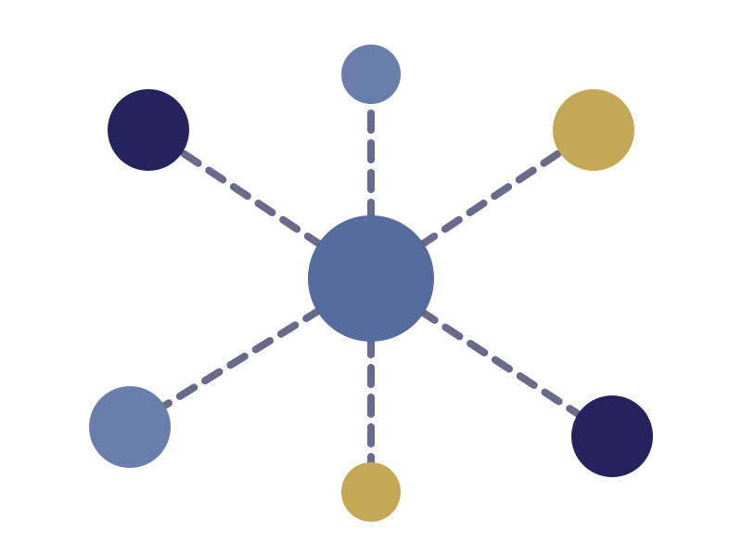

CONTENTS
Presentation Outline
1
Introduction
Abstract, problem, objectives, RAG vs GraphRAG
2
Major Modules
17 modules and an example knowledge graph
3
Technology Stack
Frontend, backend, AI, graph and data layers
4
Architecture & Pipeline
System design and document ingestion flow
5
Testing & Conclusion
Test data, questions, evaluation, summary
Lords Institute of Engineering & Technology | GraphRAG-Based Enterprise Knowledge Discovery System
2

Slide 3




1. INTRODUCTION
Abstract
Overview
An AI-powered enterprise knowledge platform that combines Knowledge Graphs, RAG, LLMs and vector search to discover information spread across organizational documents and data sources.
Ingestion & indexing
PDFs, Word files, policies, manuals and support records are ingested. NLP/LLM extraction finds entities and relationships for a graph database, while document chunks become embeddings in a vector database.
Hybrid retrieval & answers
A question triggers graph retrieval and vector retrieval together. The combined context goes to an LLM that returns a contextual, relationship-aware answer with source references.
Lords Institute of Engineering & Technology | GraphRAG-Based Enterprise Knowledge Discovery System
3

Slide 4




1. INTRODUCTION
Problem Statement
Keyword search misses context
Traditional search finds relevant documents but not how they relate to each other.
Relationships stay hidden
Links between people, projects, departments, technologies and issues are not understood.
Knowledge is scattered
Information sits across PDFs, Word files, manuals, meeting notes and support records.
Answers lack explainability
Users need source-grounded answers, not just a list of matching documents.
Lords Institute of Engineering & Technology | GraphRAG-Based Enterprise Knowledge Discovery System
4

Slide 5
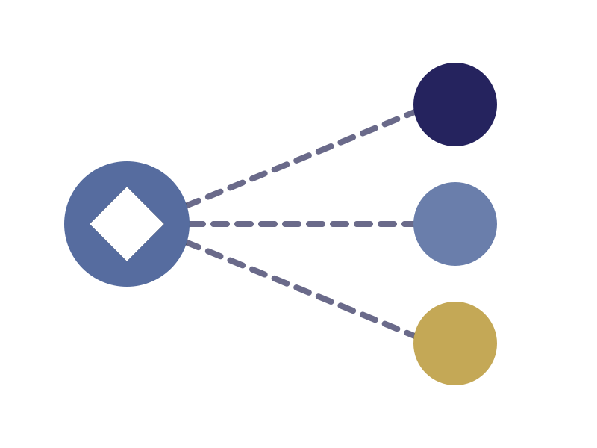



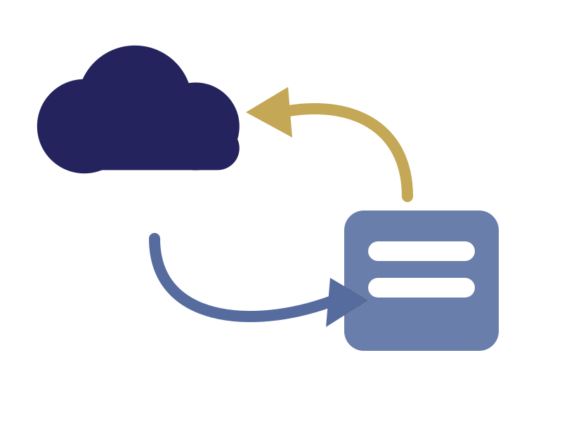



1. INTRODUCTION
Objectives of the Project
01
Build a knowledge graph of entities and relationships from enterprise documents
02
Combine graph retrieval and vector search into hybrid GraphRAG retrieval
03
Generate contextual LLM answers with source and relationship citations
04
Provide a visual Knowledge Explorer and natural-language enterprise search
05
Evaluate GraphRAG against traditional RAG on relationship-heavy questions
Lords Institute of Engineering & Technology | GraphRAG-Based Enterprise Knowledge Discovery System
5

Slide 6
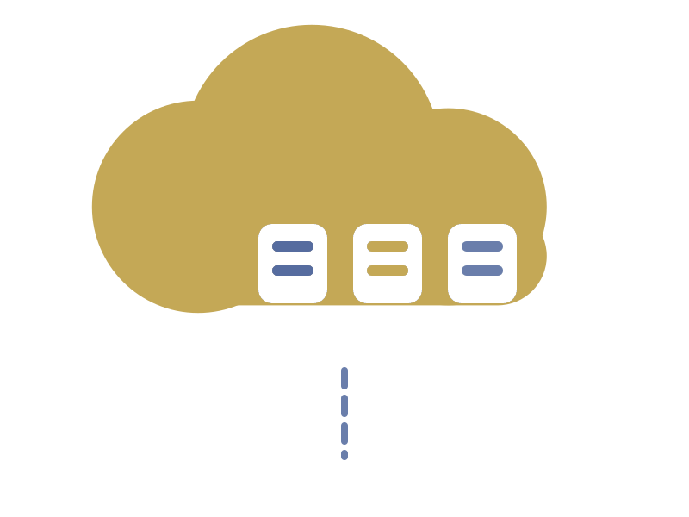


1. INTRODUCTION
Traditional RAG vs GraphRAG
RAG
GraphRAG
Keyword / semantic search
Retrieves relevant chunks
Misses links between entities
Weak on multi-hop questions
VS
Knowledge graph + vector search
Traverses entity relationships
Answers multi-hop questions
Explainable, source-grounded answers
Lords Institute of Engineering & Technology | GraphRAG-Based Enterprise Knowledge Discovery System
6

Slide 7
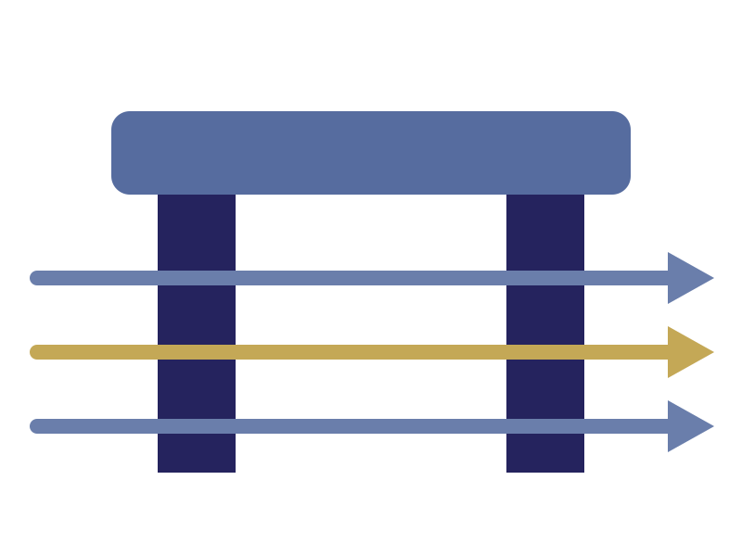





2. MAJOR MODULES · 1–17
17 Major Modules
1–4. Access & Ingestion
5–9. Knowledge Building
User & authentication, document ingestion, document processing, metadata extraction.
Entity and relationship extraction, graph construction, vector embeddings, vector database.
10–13. Retrieval & Answers
14–17. Explore & Manage
Graph retrieval, hybrid GraphRAG retrieval, LLM question answering, source & citation.
Knowledge explorer, enterprise search, feedback & evaluation, administration.
Lords Institute of Engineering & Technology | GraphRAG-Based Enterprise Knowledge Discovery System
7

Slide 8
2. MAJOR MODULES
Example Knowledge Graph
01
Employee –WORKS_ON→ Project
02
Project –USES→ Technology
03
Technology –HAS_ISSUE→ Technical Issue
04
Technical Issue –DOCUMENTED_IN→ Document
05
Rahul → Banking Payment Platform → Kafka → Consumer Lag → Incident Report
Lords Institute of Engineering & Technology | GraphRAG-Based Enterprise Knowledge Discovery System
8

Slide 9


3. TECHNOLOGY STACK
Technology Stack
Application
AI & Data Layer
React.js / TypeScript
HTML5 / CSS3
Bootstrap / Material UI
React Query + Axios
React Flow / Cytoscape.js
Java 21 + Spring Boot
Spring Security + JWT
Spring AI + OpenAI
Hybrid GraphRAG
Neo4j + Cypher
PostgreSQL + pgvector
Qdrant / Milvus
Apache Tika
PDFBox + Apache POI
Docker + Compose
GitHub Actions / Jenkins
Kubernetes (optional)
Lords Institute of Engineering & Technology | GraphRAG-Based Enterprise Knowledge Discovery System
9

Slide 10


4. ARCHITECTURE
Suggested Architecture
React Web App
Spring Boot API
Query Understanding /
GraphRAG Engine
Graph
Vector
Hybrid retrieval combines graph traversal with vector search; the context builder feeds the LLM to return an answer with sources and relationships.
Graph Search (Neo4j)
Vector Search
LLM Answer +
Sources
Context Builder
Lords Institute of Engineering & Technology | GraphRAG-Based Enterprise Knowledge Discovery System
10

Slide 11








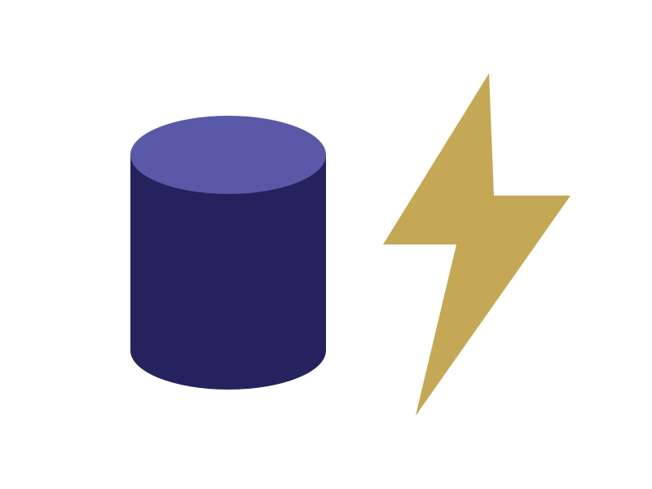



4. ARCHITECTURE
Document Ingestion & Query Pipeline
1
2
3
4
Documents (PDF, DOCX, TXT, HTML) are uploaded
Text is extracted with Tika, PDFBox and POI
Content is cleaned and split into chunks
Chunks are converted into vector embeddings
5
6
7
8
NLP / LLM extracts entities and relationships
Embeddings are stored in pgvector / Qdrant
Nodes and relationships are stored in Neo4j
Hybrid retrieval feeds the LLM: answer + sources + relationships
Lords Institute of Engineering & Technology | GraphRAG-Based Enterprise Knowledge Discovery System
11

Slide 12
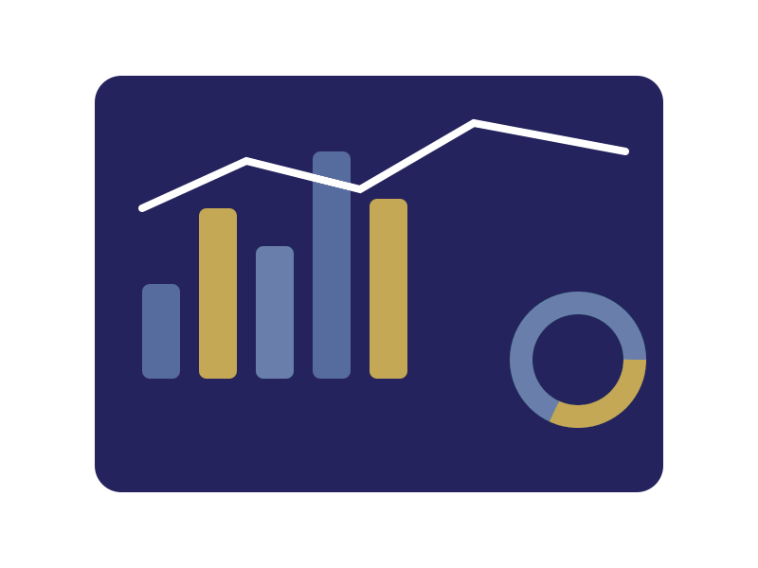

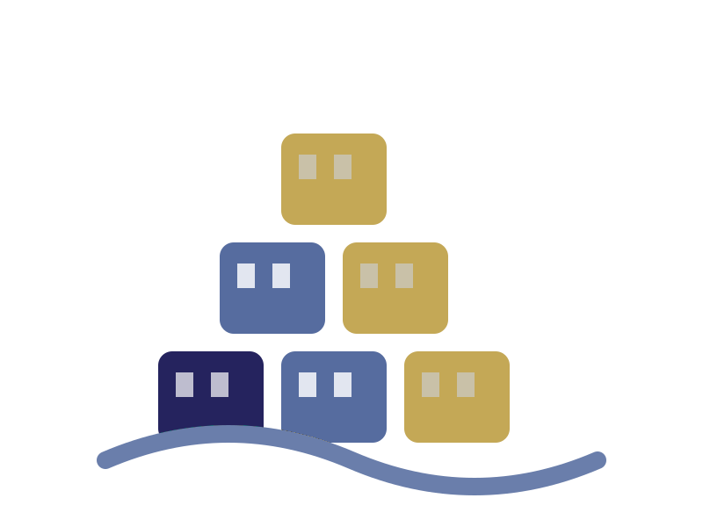

5. TESTING & CONCLUSION
Test Data & Questions
Test Dataset
Test Questions
Employees: 100–200
Projects: 30–50
Technologies: 40–60
Issues: 100–200
Documents: 50–100
Incidents: 30–50
Policies: 20–30
Tickets: 200–500
Summarize the Kafka incident
Which employees work on Kafka projects?
Which projects use Spring Boot and PostgreSQL?
Which department owns Kubernetes projects?
Kafka projects → people → incidents (multi-hop)
Active Spring Boot + Kafka projects, owners, incidents
Lords Institute of Engineering & Technology | GraphRAG-Based Enterprise Knowledge Discovery System
12

Slide 13
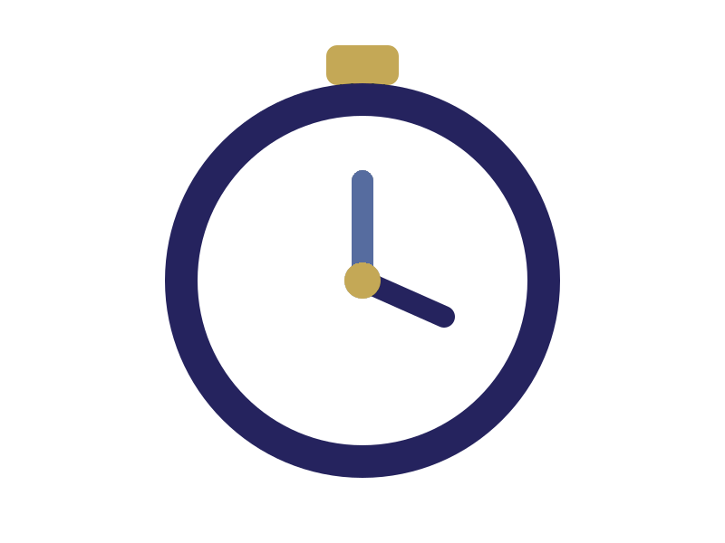

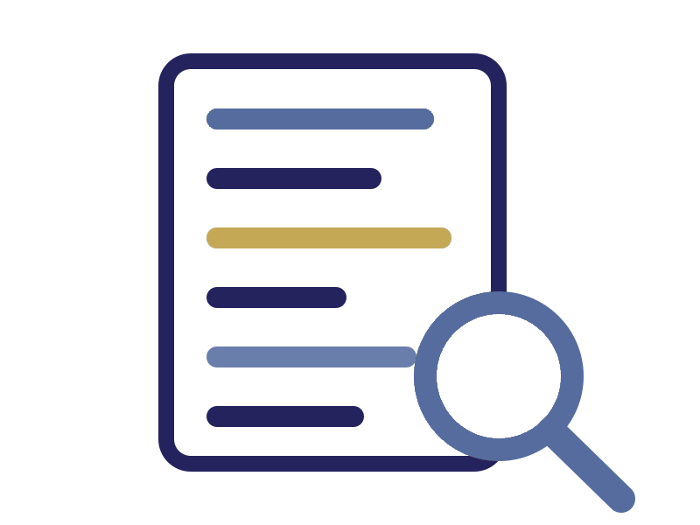


5. TESTING & CONCLUSION
Testing & Evaluation
Functional Testing
Precision & Recall
Upload, extraction, graph, search, citation, access control.
Share of results that are relevant, and relevant results found.
Answer Relevance
Grounding
Answer addresses the question; context is useful.
Answers are supported by the retrieved information.
Citation Accuracy
Response Time
Cited documents actually support the answer.
Time required to generate an answer.
Lords Institute of Engineering & Technology | GraphRAG-Based Enterprise Knowledge Discovery System
13

Slide 14


5. TESTING & CONCLUSION
Conclusion
What we built
How it works
What it delivers
An AI-powered enterprise knowledge platform combining a knowledge graph, vector search and an LLM.
Hybrid GraphRAG retrieval traverses entity relationships and fetches matching document chunks to build context.
Relationship-aware search and explainable, source-grounded answers for enterprise knowledge discovery.
Knowledge graph + vector search + LLM = explainable enterprise answers
Lords Institute of Engineering & Technology | GraphRAG-Based Enterprise Knowledge Discovery System
14

Slide 15
Thank You
GraphRAG-Based Enterprise Knowledge Discovery System
Abdul Raafeh | Mohammed Affanuddin | Patan Sameer Khan
CSE IV-B1_18

